Slide 1
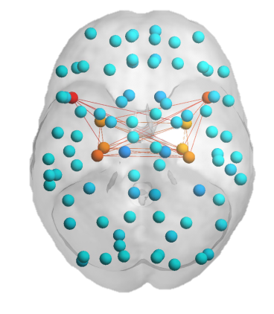
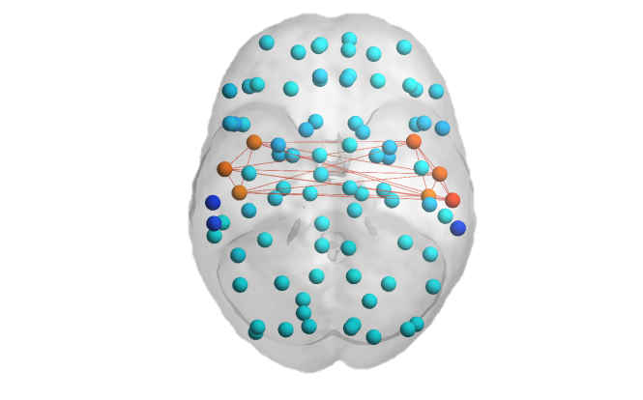
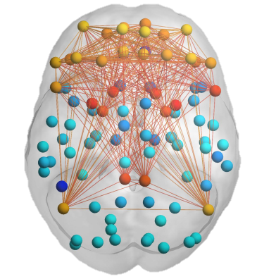
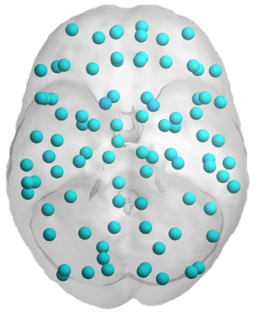



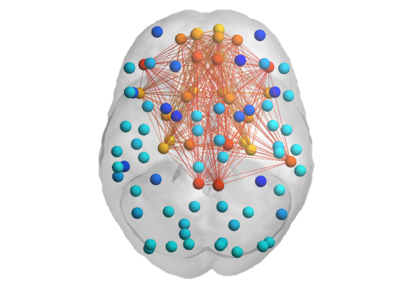


rrMDD:
neutral vs sad
Amygdala-Hippo-
campus
Insula-Auditory
FN-DMN-Striatum-SN
Global
Prefrontal-
Striatum
Somato-sensory-
Visual
Visual
≥0.20 for whole group
neutral>sad
sad>neutral
Prefrontal-Limbic
Visual-Hippocampus
Somatosensory-Insula

Slide 2
Controls:
neutral vs sad
Amygdala-Hippo-
campus
Insula-Auditory
FN-DMN-Striatum-SN
Global
Prefrontal-
Striatum
Somato-sensory-
Visual
Visual
≥0.20 for whole group
neutral>sad
sad>neutral
Prefrontal-Limbic
Visual-Hippocampus
Somatosensory-Insula

